Slide 1
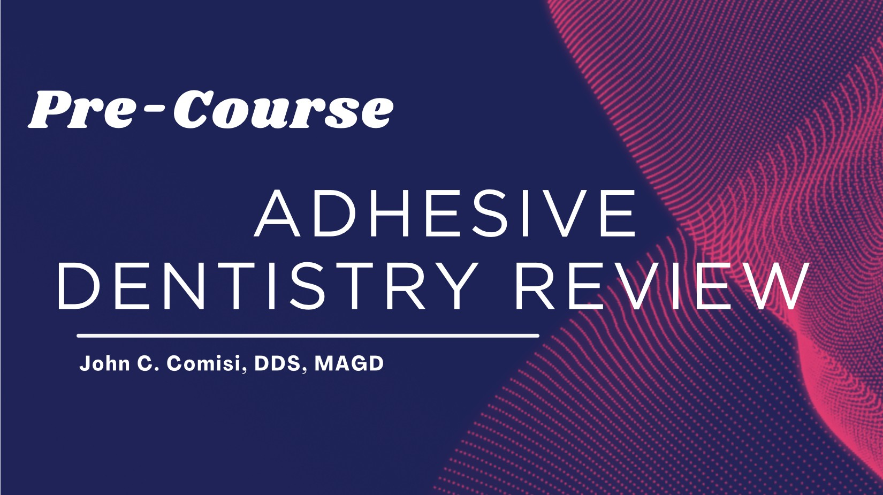

Associate Professor
Department of Reconstructive and Rehabilitation Sciences Division - Restorative Dentistry
MUSC -JBECDM
November 2023

Slide 2

The Best Preparation
NO PREPARATION!!!
Caries Management - Patient Education & Remineralization!
Surgerize ONLY when we can’t remineralize!

Slide 3
Before you Prepare a tooth….
Check for tooth Vitality!!!!

Slide 4
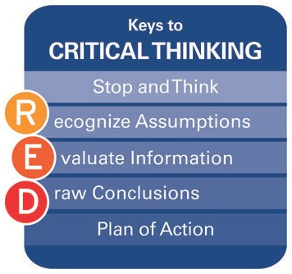



Slide 5
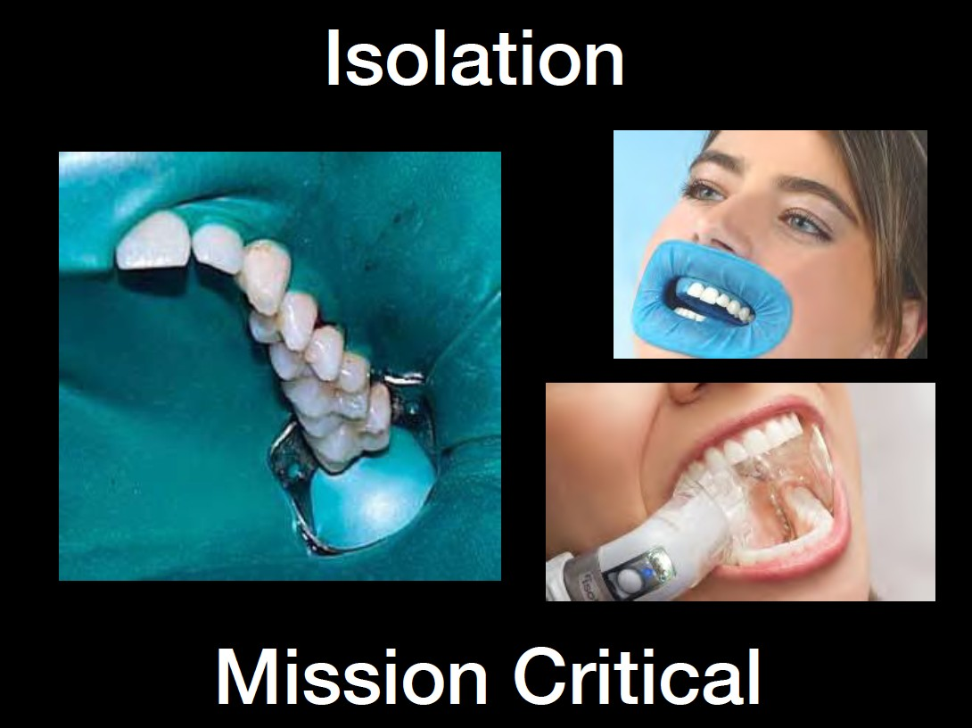

Slide 6





Etch
Disinfectant Prime
Remove Biofilm
4
S
t e p s
and Bond

Slide 7
BioFilm
Plaque and other organic material that resides on the tooth. This will inhibit an effective bond to any type of tooth structure.

Slide 8
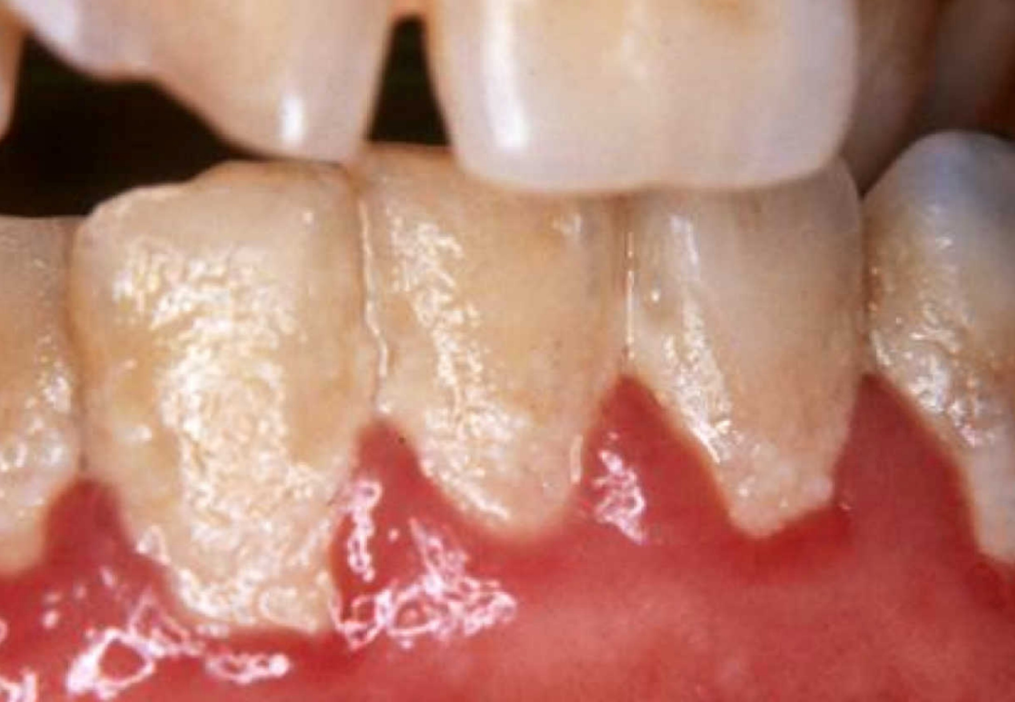

Slide 9
Smear Layer
Denatured cutting debris formed by instrumentation of dentin.
It is welded to the tooth surface. (6 MPa)

Slide 10
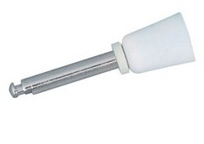
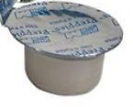
STEP #1
Cleaning the enamel removes the biofilm and smear layer on these surfaces, enhancing the overall bonding process.

Slide 11
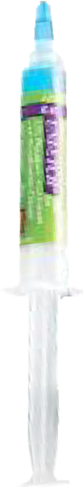

S
STEP 2 Enamel
TOTAL ETCH, 37% phosphoric acid 15 SECONDS – WASH, GENTLY DRY
On enamel, 37 % phosphoric acid etching helps remove the smear layer and create a microscopically rough surface.

Slide 12
STEP 2 Dentin
TOTAL ETCH, 37% phosphoric acid 15 SECONDS – WASH, GENTLY DRY
Etching removes the smear layer (good) but excessvie etching removes excess calcium from the hydroxyapatite (bad). You must etch properly.

Slide 13
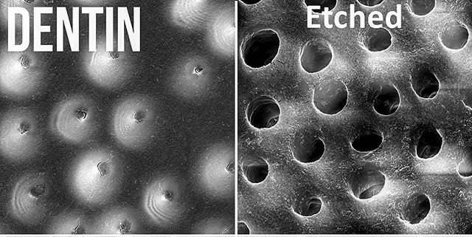
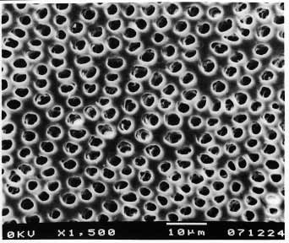
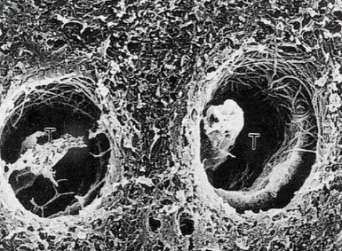

Exposed Dentin
pH~0.7

Slide 14
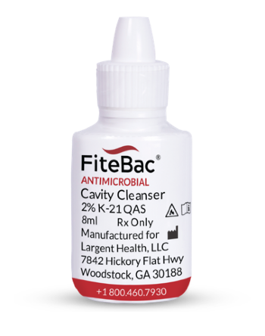
STEP 3
Apply FiteBac to enamel and dentin.
A methacrylate QAS will penetrate the dentin, remove the smear layer and mineralize the dentin to protect the dentin and kill bacteria on contact. This will enhance the long-term bond.

Slide 15
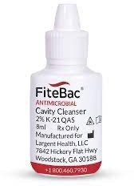
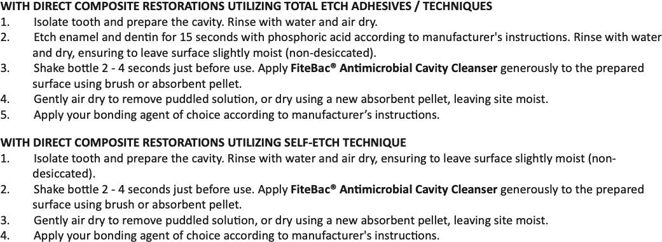
One of these two techniques MUST be employed!!!

Slide 16
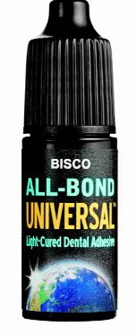
STEP 4 Bonding to Enamel and Dentin
Apply two separate coats of All Bond Universal and scrub with a microbrush for 10 -15 seconds per each coat.
Air dry after second coat for 10 second and light cure for 10 seconds.

Slide 17
LIGHT CURING!!
If energy is not available, the components will NOT cure!!

Slide 18
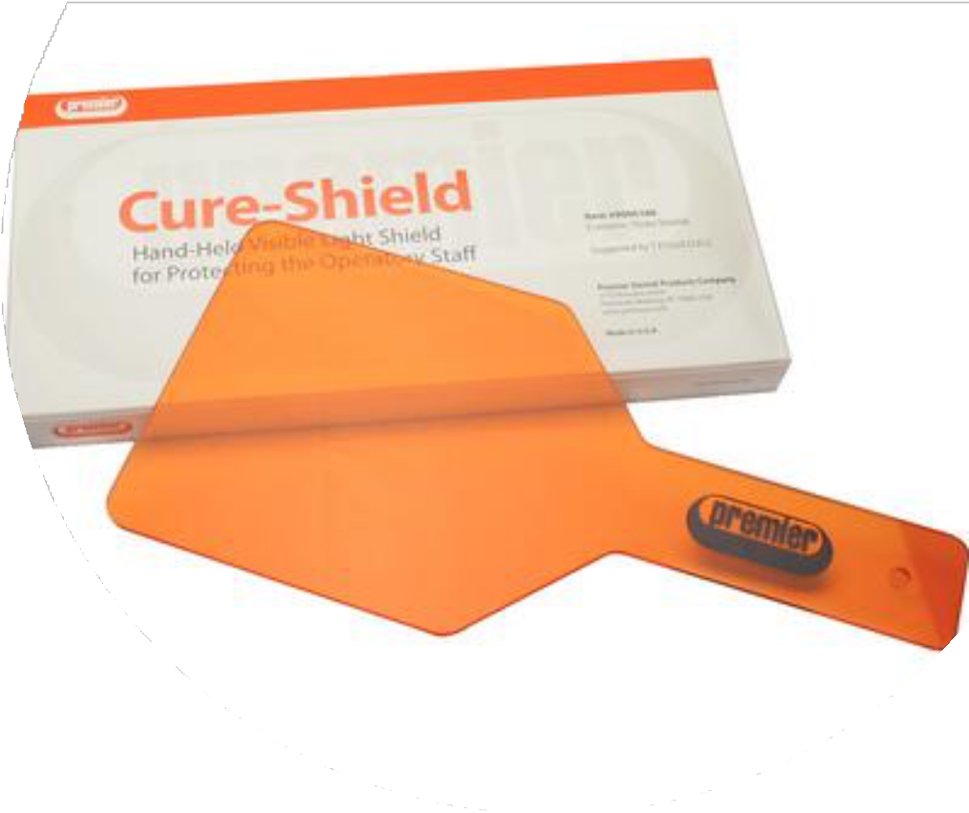
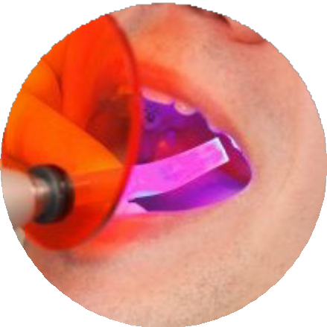
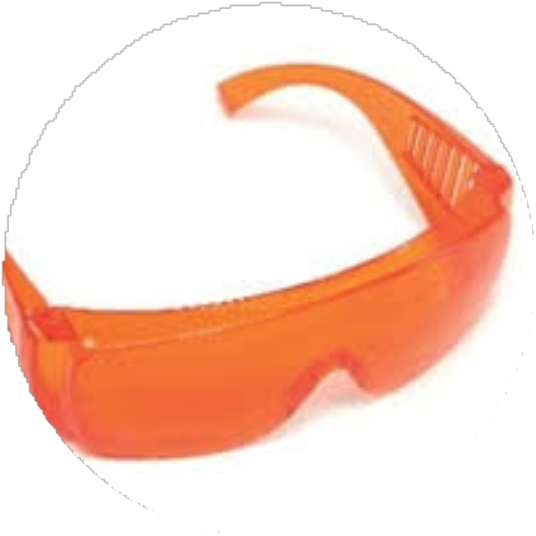


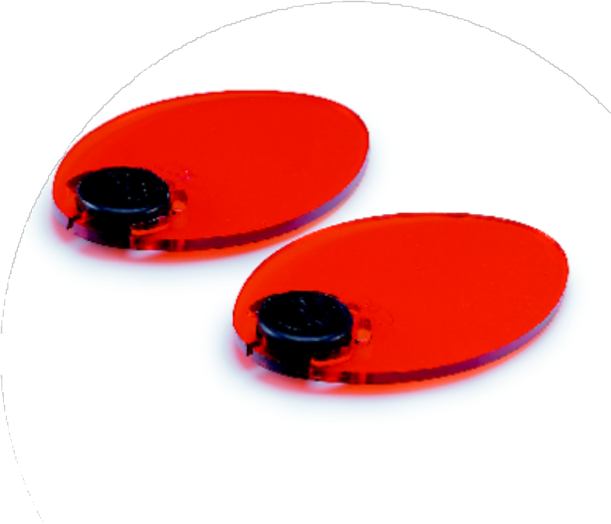
Pre-Exposure Checklist for Light Curing Unit
Safety precautions
Eye safety is required

Slide 19
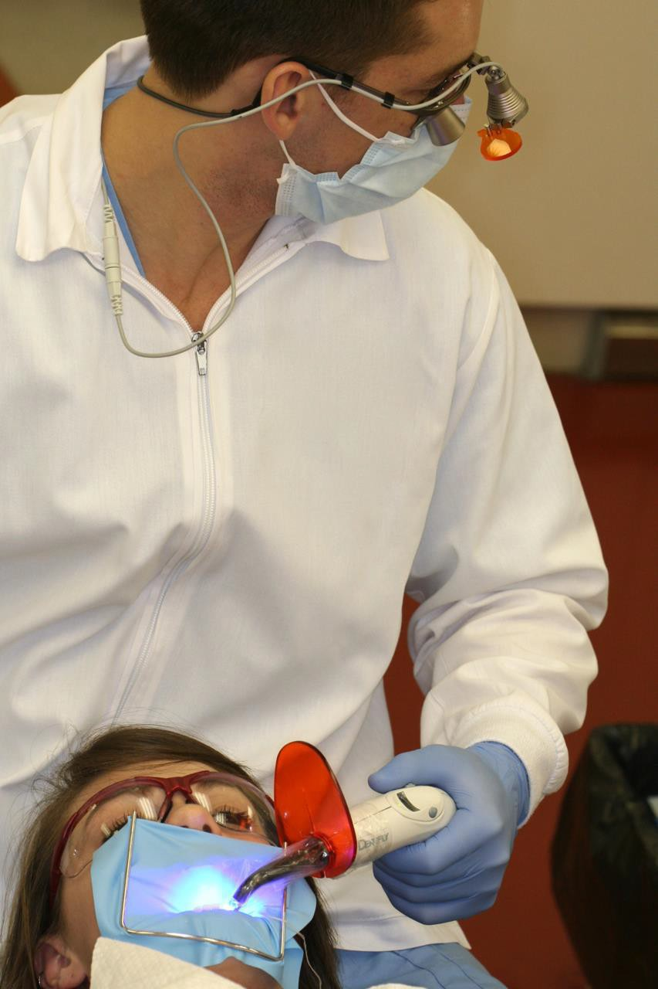


This is a Recipe for Failure

Slide 20
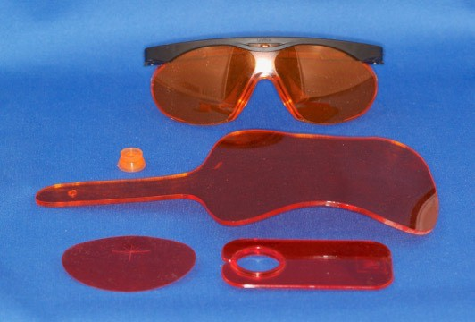
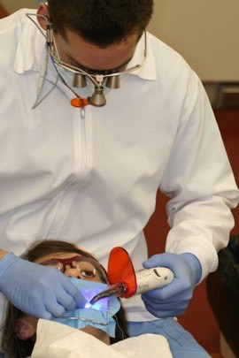
Must Use Eye Protection

Slide 21
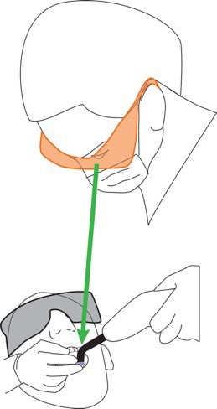
Wear Eye Protection
Stabilize tip
Watch when light curing

Slide 22
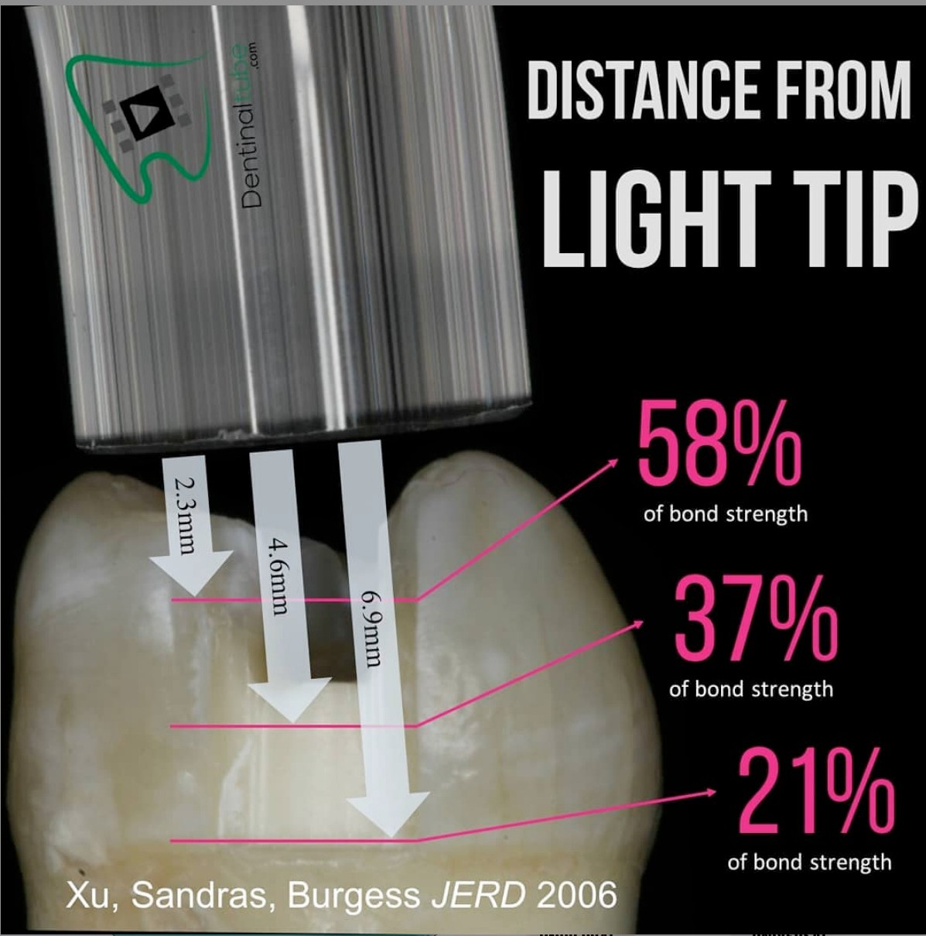
Optimizing Clinical Effectiveness
Curing light needs to be close to and effectively cover the entire restoration, or need to overlap the curing of the restoration to be sure to achieve maximum possible cure. The deeper the prep, the more light energy is needed.
A Plastic Sleeve on the curing light is optimally needed, make sure seem of plastic sleeve does not cross over the curing light aperture.

Slide 23
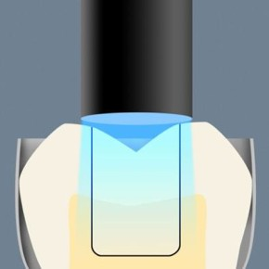

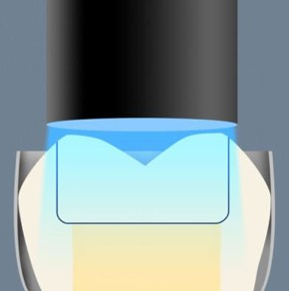


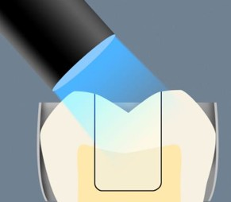
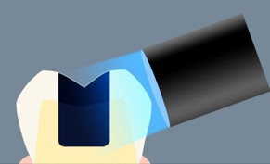
Tip Position
Optimizing Clinical Effectiveness
Factors during exposure
Tip positioning (create no shadows) Minimize tip-to-target distance.
Direct observation of target during exposure. (LOOK at the restoration with eye protection!!!)
Keep the light STABLE on the tooth.
Adjust exposure duration for decrease in power of light.
If curing longer, air cool the tooth with air/water syringe.

Slide 24
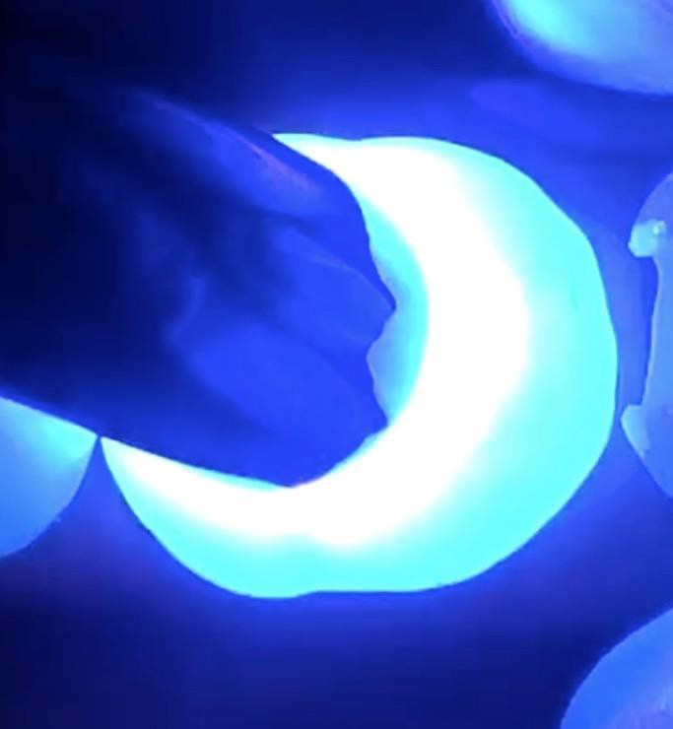
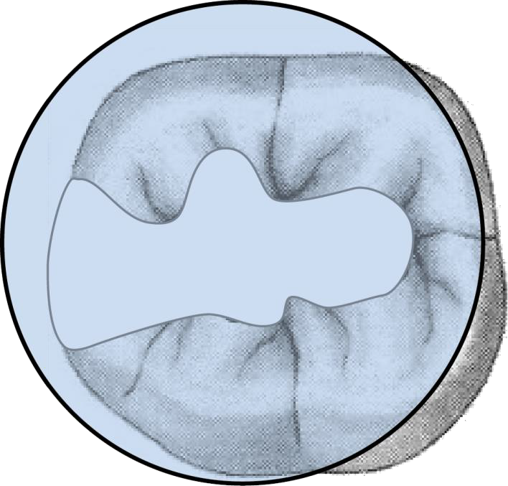

Cover Restoration with Tip

Slide 25

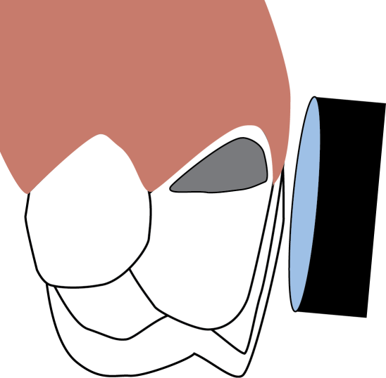
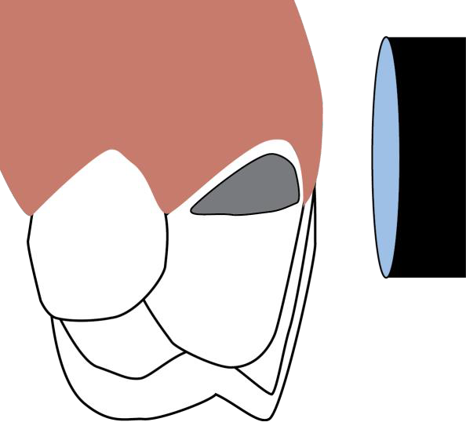
Position Light ToMinimize Thermal Damage ToSoft Tissue

Slide 26
Review:
What are the 4 steps involved in the bonding
process and what is the purpose of each?
Biofilm Removal, Etch, disinfect, prime/bond
Review the smear layer and its importance in bonding.
Debris that is fused to the dentin. Must be removed or modified to bond well.
Know the mechanism by which composites bond
to teeth.
Micro-mechanical/mineral exchange (with use of functional monomers).
Which bonding system do we use here at MUSC and what are the steps for application?
All Bond Universal.
Steps: Preppies, Etch (15 secs, wash and gently dry), Disinfect with FiteBac, apply two coats (scrub 10-15 seconds each coat) which enables prime/bond to occur, air dry 10 seconds after second coat and then light cure 10 seconds).
John C Comisi, DDS, MAGD

